Slide 1

Case Study: Intelligent Systems in Production
RL-Driven Warehouse Item Relocation Optimization
Prof. Hamidreza Heidari
Binil Sajeev, Abdelraheem Zekry, Orlando Manrique, Arthur Reis

Slide 2

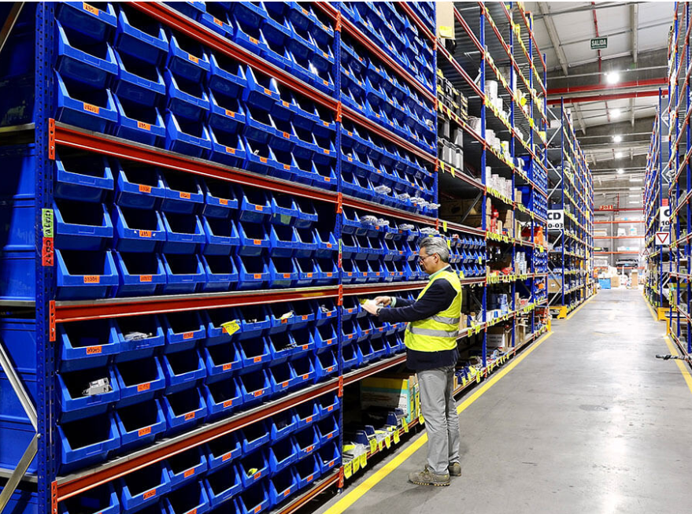
THE SETUP | Overview
Target Size(real-world complexity)
100.000 Locations
10 Location Types
70.000 Unique Parts
1 Million Units
Prototype Size(Phase 1)
400 Locations
3 Location Types
50 Unique Parts
15.000 Units

Slide 3
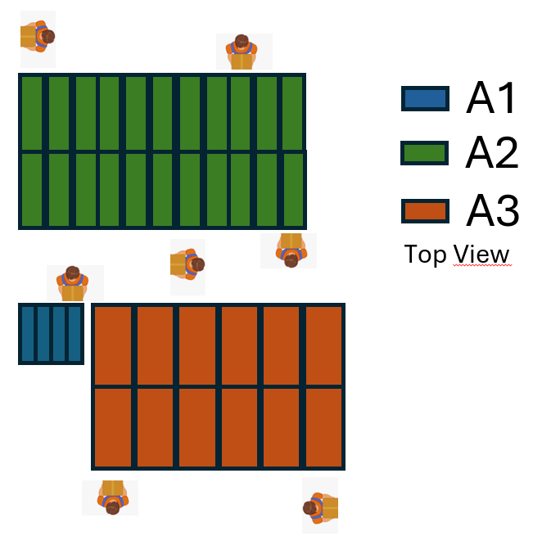
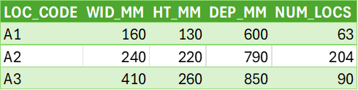
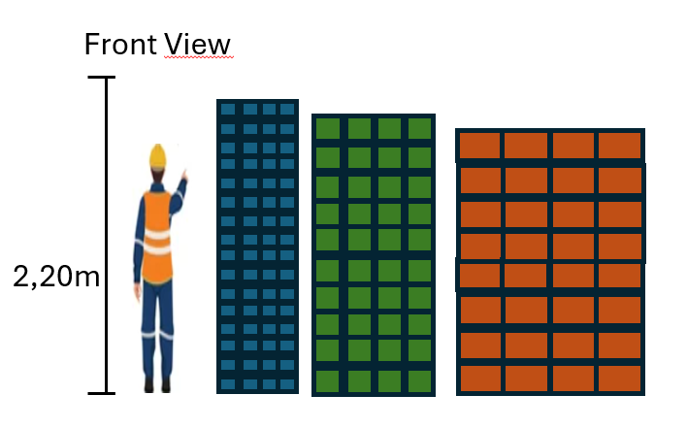
THE SETUP | Layout and Locations

Slide 4
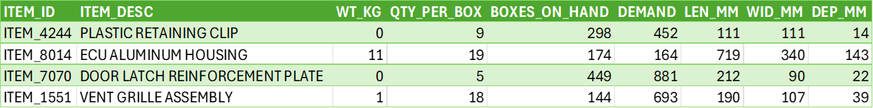
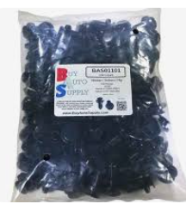
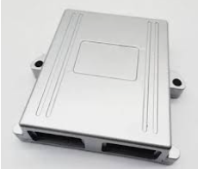
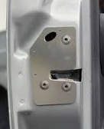
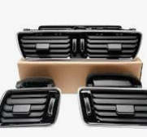
THE SETUP | Parts

Slide 5
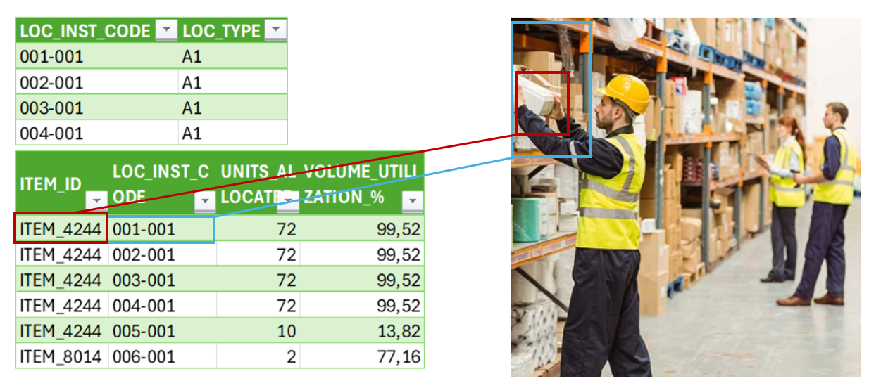
THE SETUP | Initial Allocation

Slide 6
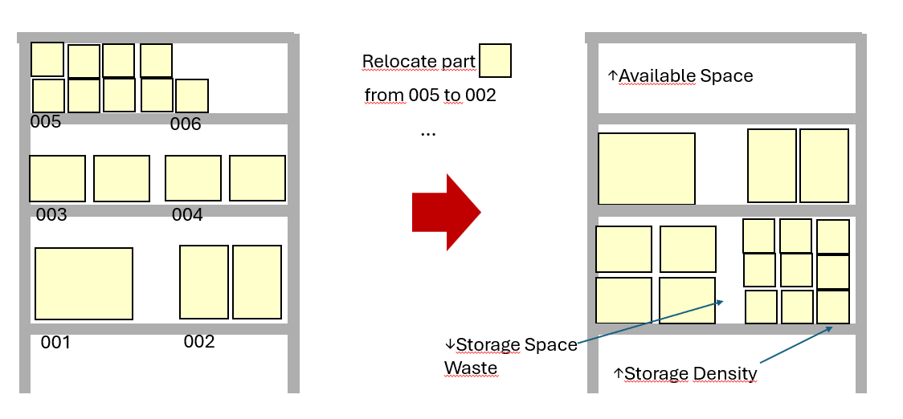
RELOCATION WORKFLOW

Slide 7
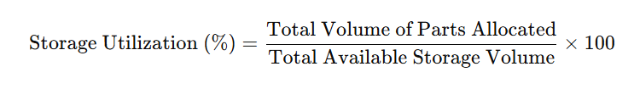
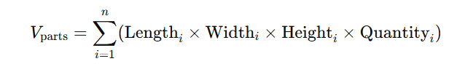
POTENTIAL IMPACT - KPI

Slide 8
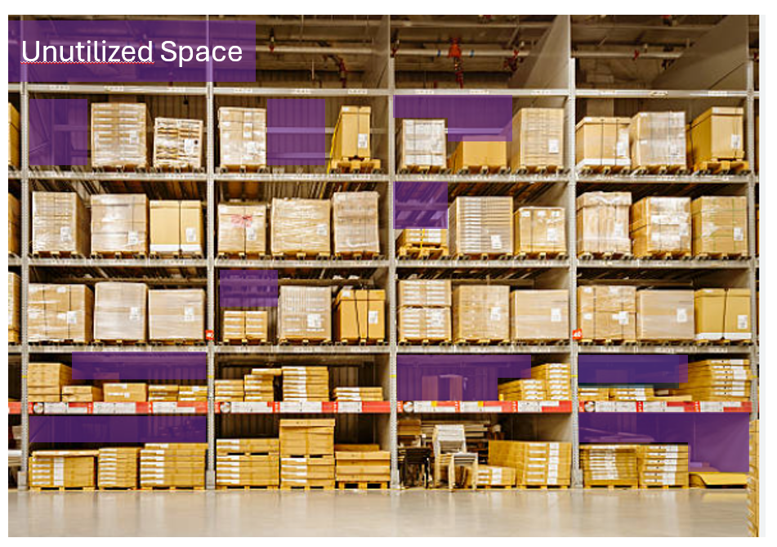
POTENTIAL IMPACT - KPI
Initial State
Total warehouse volume: 20,248 m³
Total parts volume: 12,757 m³
KPI - Utilization of active locations: 63%
Target After Densification
Total warehouse volume: 20,248 m³
Total parts volume: 14,671 m³
KPI - Utilization of active locations: 72.5% utilization)
Space freed for ~1,914 m³ new inventory

Slide 9
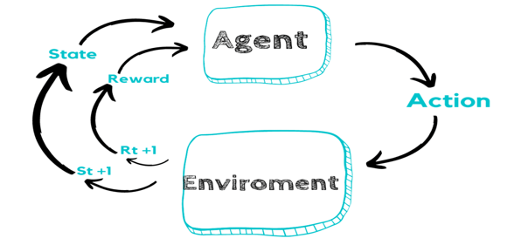
REINFORCEMENT LEARNING
A branch of Machine Learning where an agent learns by doing.
The agent interacts with its environment, trying actions and observing outcomes.
It receives rewards or penalties based on how good its actions are.
Over time, it learns an optimal policy — a strategy that maximizes total rewards and minimizes mistakes.

Slide 10
HOW RL WORKS IN OUR CASE
GOAL
To maximize space utilization while minimizing unnecessary movement operations.
Model as a Markov Decision Process (MDP)
MDP COMPONENTS
State: Current item locations
Environment: The external world with which the agent interacts.
Action: Move item i from slot A → B (relocation)
Policy: Strategy the agent develops to decide which actions maximizes cumulative reward.

Slide 11
HOW RL WORKS IN OUR CASE
Reward: Feedback from the environment tells the agent how good or bad last action was.
Episode: Number of relocation steps to reach goal per simulation
RL APPROACH
Build a warehouse simulator
Train an RL agent to select relocations
Use reward shaping & action masking to ensure valid moves
EVALUATION OF MODEL
Optimization baselines & the previous condition the warehouse was
Storage utilization, Travel time in warehouse, Relocation Cost

Slide 12
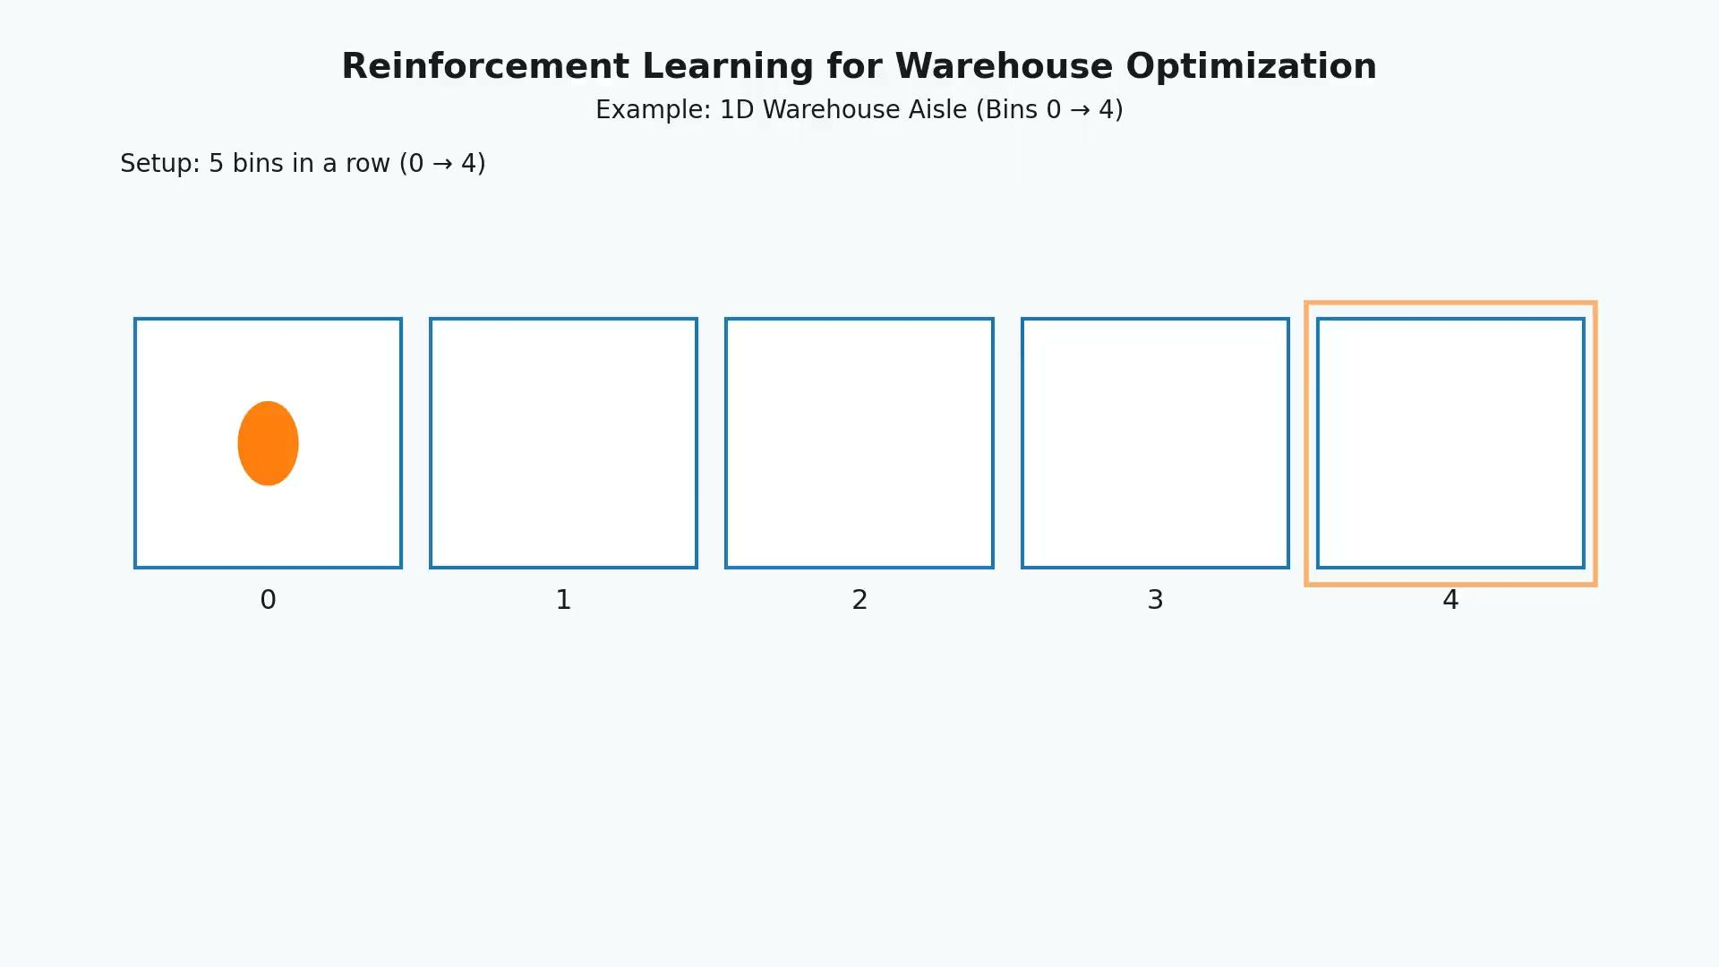
HOW RL WORKS IN OUR CASE

Slide 13
WHY RL OVER ML & HEURISTIC METHODS?
RL Advantages
Ideal for dynamic, sequential decision-making — like item relocation in warehouses.
Learns by interacting with the environment and adapts to changing demand patterns.
Considers the long-term impact of each action, not just immediate outcomes.
Autonomously discovers and refines strategies to optimize space and efficiency.

Slide 14
WHY RL OVER ML & HEURISTIC METHODS?
ML & Heuristic Limitations
ML models depend on historical data and need retraining when conditions change.
Heuristic methods are simple and fast but rule-based — they struggle to adapt or find globally optimal solutions in complex, evolving warehouse settings.

Slide 15
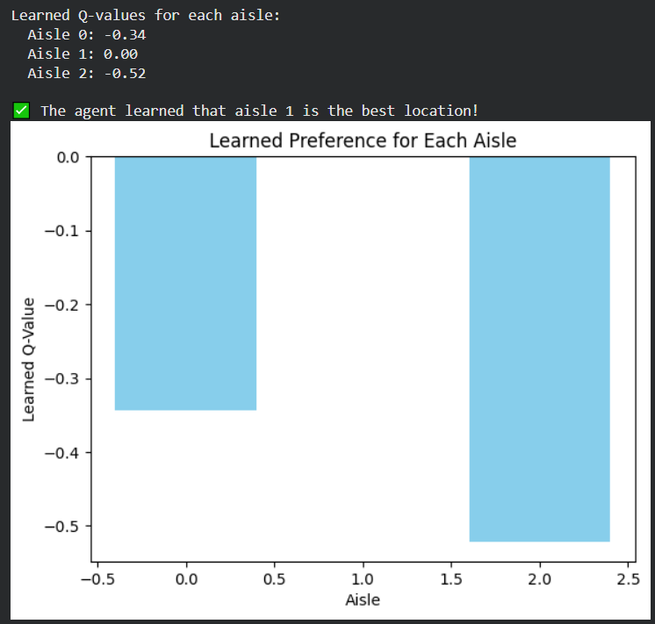
BASELINE RL MODEL - PROOF OF CONCEPT
Setup
Warehouse simulated with 3 aisles → Aisle 0, 1, and 2
The agent selects an aisle, receives a reward based on its distance to the target aisle (1)
Q-values are updated after each trial to learn which aisle gives the best long-term reward
After training, the highest Q-value identifies the best aisle for item placement
Result: The agent learned that Aisle 1 is the optimal location, as shown by its highest Q-value. (This forms the foundation for scaling up to a larger dynamic warehouse environment.)

Slide 16
THANK YOU
Binil Sajeev, Abdelraheem Zekry, Orlando Manrique, Arthur Reis

